Slide 1

Final Panel Presentation
New Zealand Tourism Forecasting
LSG - Lakshya Mann, Shivam Arora, Gowtham R Panicker
Client Name: Dr. Trang Do

Slide 2
Table of Contents
1. Title Slide
3. Team Members
4. Project Overview
5. Project Development
6. Methodology
7. Sprint Overview
8. Research and Tools
9. How the project was tested
10. Deliverables Completed
11. Model Comparison and Accuracy Evaluation
• Transaction Spending Forecasts (ARIMA, SARIMAX, VAR, Random Forest) (12-19)
• Accommodation Forecasts (Domestic, International, Total Guest Nights) (21-24)
• Visitor Arrival Forecasts (Domestic & International) (26-29)
30. Dashboard Overview
• Summary Page (31)
• Guest Nights Page (32)
• Visitor Arrivals Page (33)
• Spending Page (34)
• Live demonstration (35)
36. Testing and Validation
37. Test Cases
38. Testing Evidence
39. Testing Evidence (Cont’d)
40. Testing Conclusion
41. Key Milestones
42. Changes in Methodology, Deliverables, or Dates
43. Trello
44. Gantt Chart (Period One)
45. Gantt Chart (Period Two)
46. Client Feedback
47. Thank You

Slide 3
3.Team Members
Lakshya Mann – Project Manager and Backup Data Analyst
Shivam Arora - Data Analyst
Gowtham R Panicker - Data Analyst

Slide 4
4.Project Overview
Developed an intelligent tourism forecasting system for New Zealand to support data-driven decision-making across the tourism sector.
Addressed limitations of manual and outdated forecasting methods that lacked analytical accuracy, real-time adaptability, and visual insights.
Created a data-driven forecasting framework integrating machine-learning models (ARIMA, SARIMAX, VAR, Random Forest) with interactive visualisation for accurate and interpretable predictions.
Guided by client deliverables from Dr Trang Do, ensuring the system aligned with practical and analytical needs of tourism authorities.
Adopted an Agile methodology with iterative sprints, continuous testing, and advisor feedback to maintain flexibility and ensure consistent progress.
Produced a transparent and accessible forecasting solution that enhances accuracy and empowers stakeholders to plan strategically and respond effectively to emerging tourism trends.

Slide 5
5.Project Development
Development of the New Zealand Tourism Forecasting System followed an Agile approach, progressing through structured sprints to create a fully functional forecasting solution.
Early stages focused on environment setup, dataset identification, and data preparation, ensuring quality and consistency for analysis.
Successive phases included developing and comparing models such as ARIMA, SARIMAX, VAR, and Random Forest to achieve accurate and stable tourism forecasts.
An interactive Power BI dashboard was designed to visualise processed and forecasted data through clear, comparative visuals for easier interpretation.
Each sprint involved testing, feedback, and refinement, maintaining alignment with deliverables defined by Dr Trang Do.
The outcome delivers accurate, transparent, and actionable insights to support data-driven decision-making in New Zealand’s tourism sector.

Slide 6
6.Methodology
The project followed the Agile methodology to maintain organisation, flexibility, and consistency throughout development.
Each sprint lasted approximately two weeks, with the final sprint extended for documentation and presentation preparation.
Agile enabled the work to be divided into smaller, manageable goals, supporting regular testing, feedback, and improvement.
Weekly advisor meetings were conducted to review progress, identify challenges, and plan subsequent tasks.
Trello was used for task management and sprint tracking, while OneDrive supported version control and team collaboration.
Each sprint concluded with evaluation and feedback, ensuring continuous improvement and alignment with project deliverables.

Slide 7
7. Sprint Overview
Sprint 1:
Project Foundation
Sprint 2:
Data Integration and Quality Framework
Sprint 3:
Initial Forecasting Model Development
Sprint 4: Model improvement and visualisation
Sprint 5: Final testing, validation, and presentation preparation
Environment setup
Team coordination
Defining roles, and identifying key
Tourism data
Sources to establish the project scope and objectives.
Developed the ETL process.
Cleaned and validated data
Created a consistent, transformed dataset ready for analysis.
Implemented baseline models including ARIMA, SARIMAX, VAR, and Random Forest,
Tested early results, Identified seasonal and long-term tourism patterns.
Improved model accuracy through cross-validation,
Developed initial Power BI prototypes for trend analysis and performance evaluation
Conducted extensive model evaluation and comparison
Finalised and polished the Power BI dashboards
Final deliverables reports

Slide 8
8. Research and Tools
The project was supported by both research and the use of technical tools at each stage of development.
Research:
Reviewed academic and industry papers on tourism demand forecasting.
Compared models such as ARIMA, SARIMAX, VAR, Random Forest to identify strengths and limitations.
Analysed official datasets from MBIE for trends, spending patterns, and post-COVID recovery insights.
Used findings to guide model selection, tuning, and evaluation criteria.
Tools:
Python – for data cleaning, transformation, and model development.
Power BI – for interactive dashboards and trend visualisation.
OneDrive – for file sharing and collaboration.
Trello – for sprint tracking, task management, and progress monitoring.

Slide 9
9. How the project was tested
Data and model testing was conducted to ensure accuracy, consistency, and reliability throughout the project.
Model Testing:
Measured forecasting accuracy using RMSE, MAE, and MAPE.
Compared results across ARIMA, SARIMAX, VAR, and Random Forest models.
Applied cross-validation to check model stability and avoid overfitting.
Assessed prediction intervals to understand confidence levels in forecasts.
Data Validation:
Verified dataset quality after cleaning and transformation.
Checked for missing, duplicated, or inconsistent records.
Ensured correct time-series alignment and date formatting before model training.
Dashboard Verification:
Reviewed Power BI visuals for accuracy and responsiveness.
Validated all graphs, filters, and summary metrics against model results.

Slide 10
10. Deliverables Completed
Successfully completed all deliverables outlined by Dr Trang Do, ensuring each aligned with project goals and client expectations.
Completed Deliverables:
1. Data Preparation: Cleaned, transformed, and validated tourism datasets from MBIE and TEIC.
2. Forecasting Models: Developed and compared ARIMA, SARIMAX, VAR, and Random Forest models for accurate tourism predictions.
3. Interactive Dashboard: Designed a clear and functional Power BI dashboard for visualising processed and forecasted data.
4. Documentation: Prepared full technical documentation covering research, methodology, results, and user guidance.

Slide 11
11. Model Comparison and Accuracy Evaluation
For the three-month forecasting of transaction spending by domestic and international tourists, four models, ARIMA, Random Forest, SARIMAX, and VAR were applied. Among these, the ARIMA model demonstrated the highest accuracy, evaluated using a 12-month hold-out precision error method with metrics such as RMSE, MAE, MAPE, and sMAPE.

Slide 12
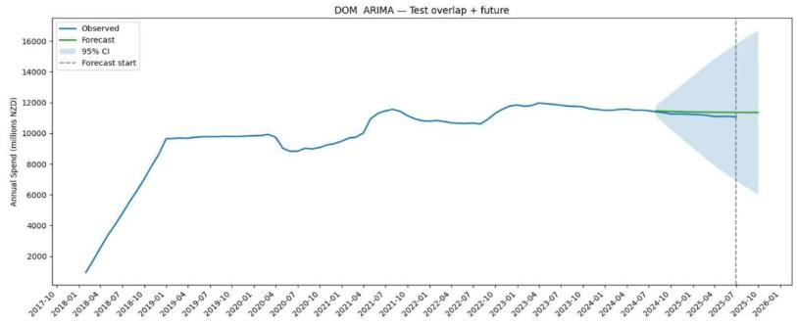
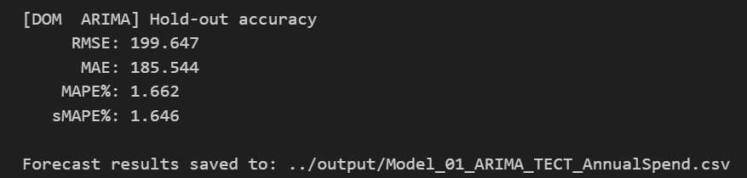
12.Three Months Transaction Card Spending Forecasting– Domestic Tourist -ARIMA Model
Hold-Out Accuracy – Domestic Tourist

Slide 13
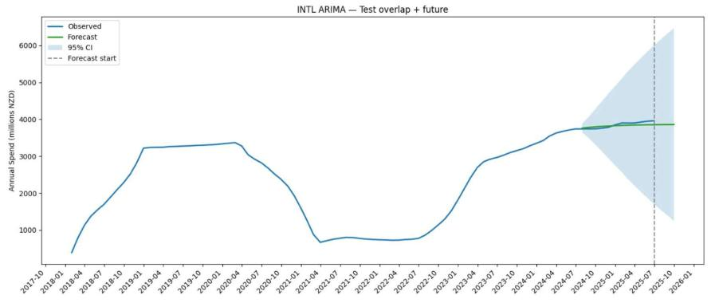
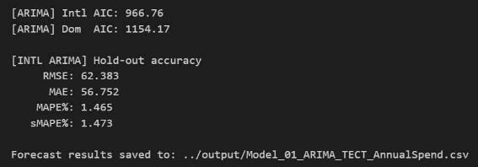
13. Three Months Transaction Card Spending Forecasting – International Tourist - ARIMA Model
Hold-Out Accuracy – International Tourist

Slide 14
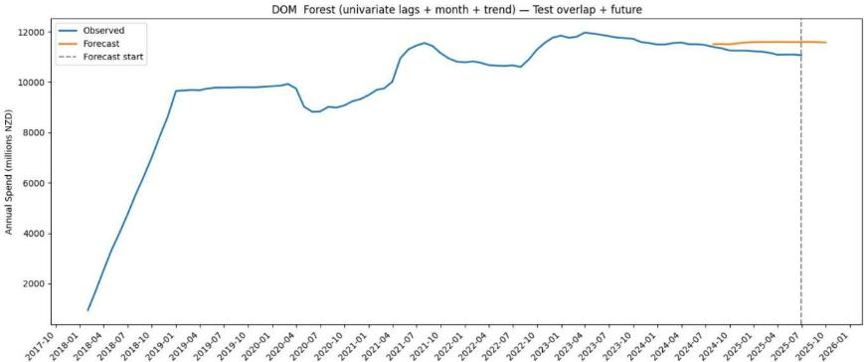
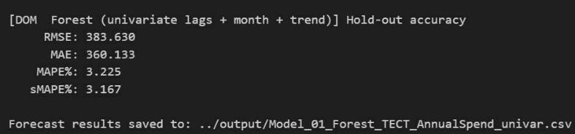
14. Three Months Transaction Card Spend Forecasting – Domestic Tourist
Forest Model
Hold-Out Accuracy – Domestic Tourist

Slide 15
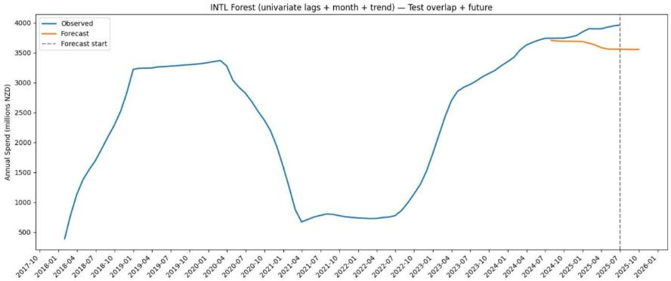
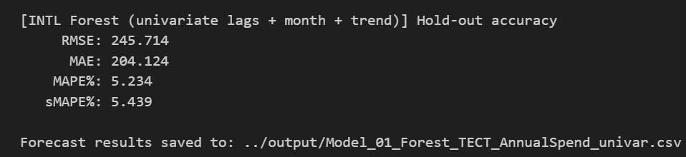
15. Three Months Transaction Card Spend Forecasting – International Tourist - Forest Model
Hold-Out Accuracy – International Tourist

Slide 16
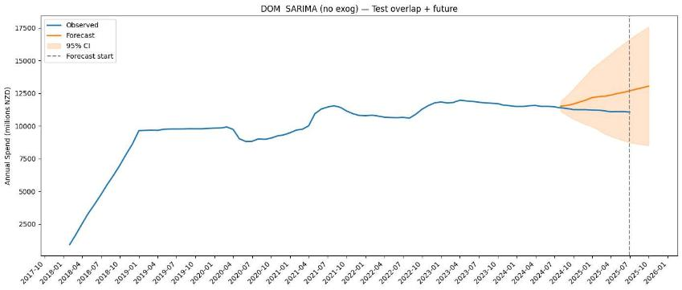
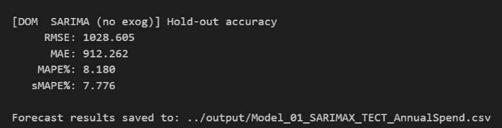
16. Three Months Transaction Card Spending Forecasting – Domestic Tourist - SARIMA Model
Hold-Out Accuracy – Domestic Tourist

Slide 17
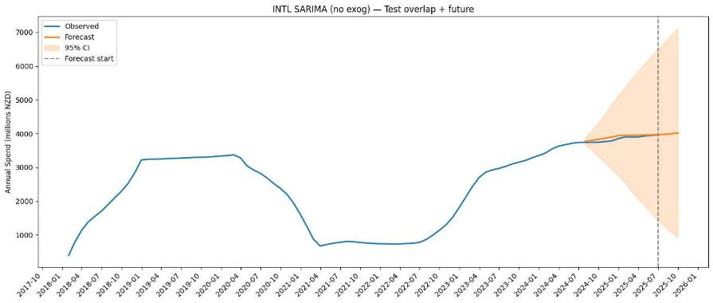
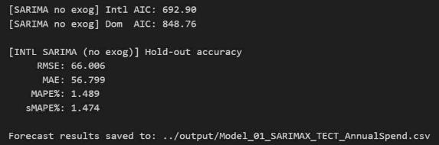
17. Three Months Transaction Card Spending Forecasting – International Tourist - SARIMA Model
Hold-Out Accuracy – International Tourist

Slide 18
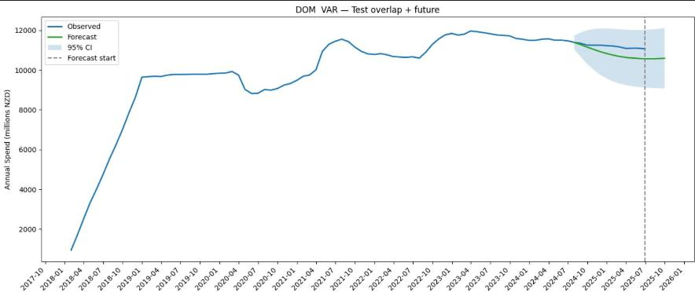
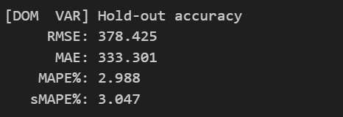
18. Three Months Transaction Card Spending Forecasting – Domestic Tourist - VAR Model
Hold-Out Accuracy – Domestic Tourist

Slide 19
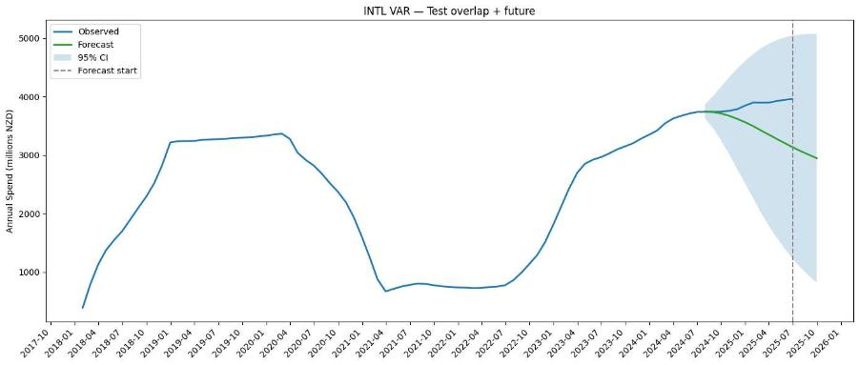
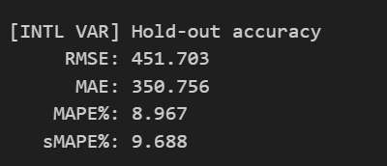
19. Three Months Transaction Card Spending Forecasting – International Tourist - VAR Model
Hold-Out Accuracy – International Tourist

Slide 20
20. Model Comparison and Accuracy Evaluation
For the three-month forecasting of accommodation by domestic, international, and total guest nights, four models, ARIMA, Random Forest, SARIMAX, and VAR were applied. Among these, the VAR model demonstrated the highest accuracy, evaluated using a 12-month hold-out precision error method with metrics such as RMSE, MAE, MAPE, and sMAPE.

Slide 21
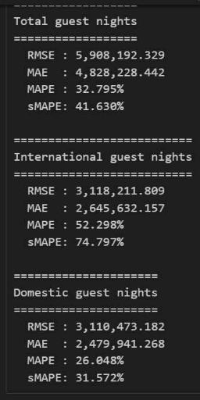
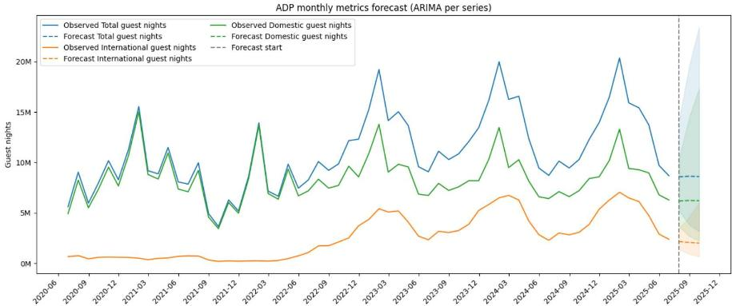
21. Three Months Accommodation Forecasting – Domestic, International, Total Guest Nights
ARIMA Model
Hold-out Accuracy – Domestic, International & Total Guest Nights

Slide 22
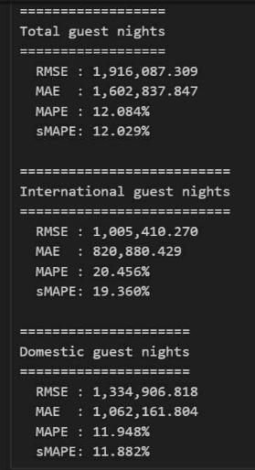
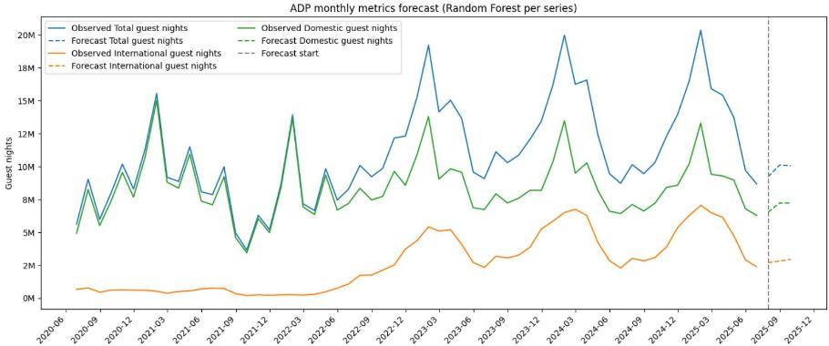
22. Three Months Accommodation Forecasting – Domestic, International, Total Guest Nights
Forest Model
Hold-out Accuracy – Domestic, International & Total Guest Nights

Slide 23
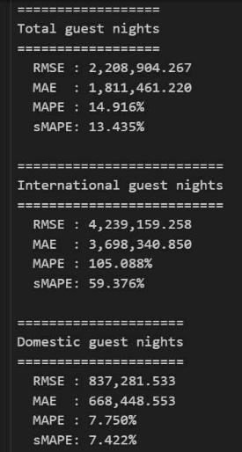
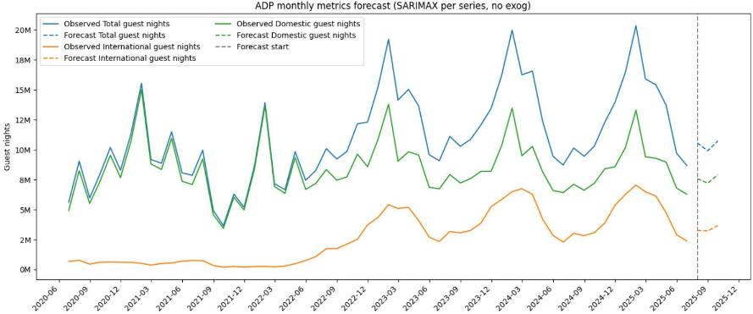
23. Three Months Accommodation Forecasting – Domestic, International, Total Guest Nights
SARIMAX Model
Hold-out Accuracy – Domestic, International & Total Guest Nights

Slide 24
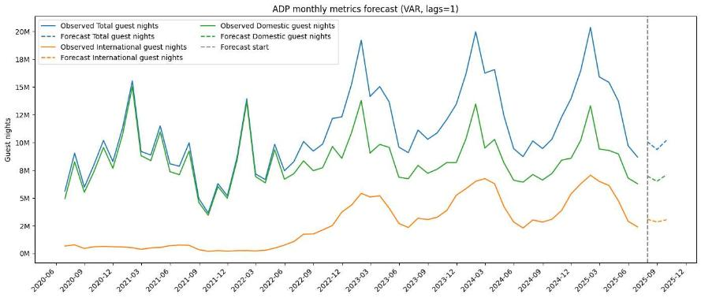
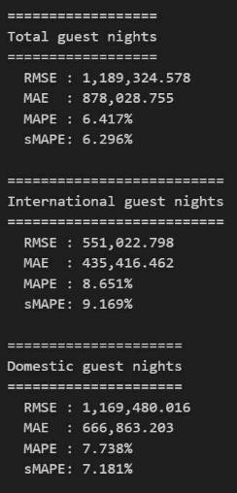
24. Three Months Accommodation Forecasting – Domestic, International, Total Guest Nights
VAR Model
Hold-out Accuracy – Domestic, International & Total Guest Nights

Slide 25
25. Model Comparison and Accuracy Evaluation
For the three-month forecasting of Visitors arrival, four models ARIMA, Random Forest, SARIMAX, and VAR were applied . Among these, the VAR model demonstrated the highest accuracy, evaluated using a 12-month hold-out precision error method with metrics such as RMSE, MAE, MAPE, and sMAPE.

Slide 26
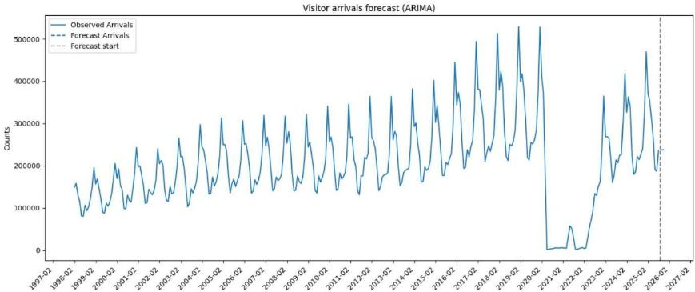
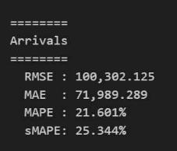
26. Three Months Visitors Arrivals Forecasting
ARIMA Model
Hold-out Accuracy – Visitors Arrivals

Slide 27
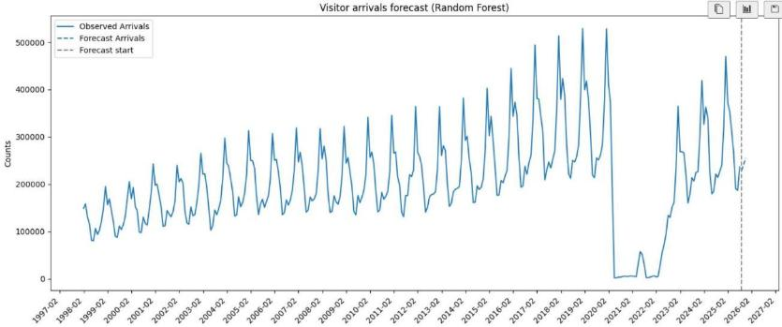
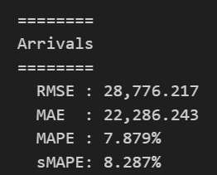
27. Three Months Visitors Arrivals Forecasting
FOREST Model
Hold-out Accuracy – Visitors Arrivals

Slide 28
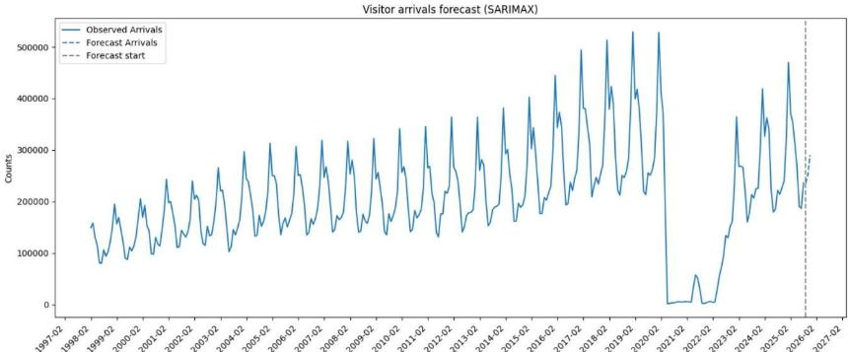
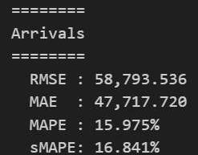
28. Three Months Visitors Arrivals Forecasting
SARIMAX Model
Hold-out Accuracy – Visitors Arrivals

Slide 29
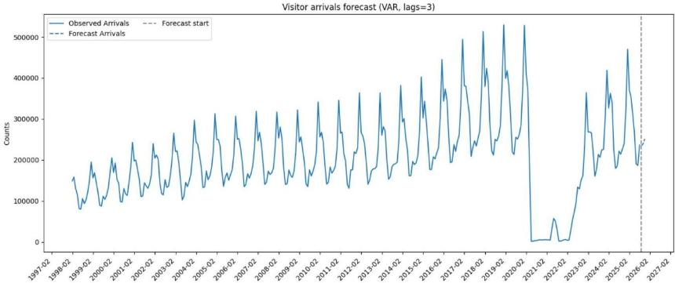
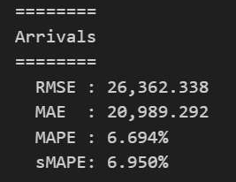
29. Three Months Visitors Arrivals Forecasting
VAR Model
Hold-out Accuracy – Visitors Arrivals

Slide 30
30. Dashboard Overview
The dashboard was designed to turn our forecasting results into an easy-to-understand visual tool for stakeholders.
It consists of four main pages:
1. Summary Page
2. Guest Nights
3. Visitor Arrivals
4. Domestic and International Spend

Slide 31
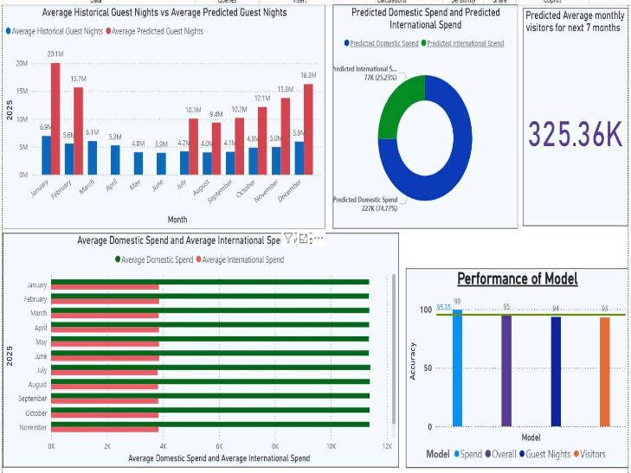
31. Summary Page
• Displays KPIs for visitor arrivals, spend, and model accuracy.
• Donut chart compares domestic vs. international spend.
• Bar chart shows historical vs. predicted guest nights.
• Provides a quick snapshot of tourism performance.

Slide 32
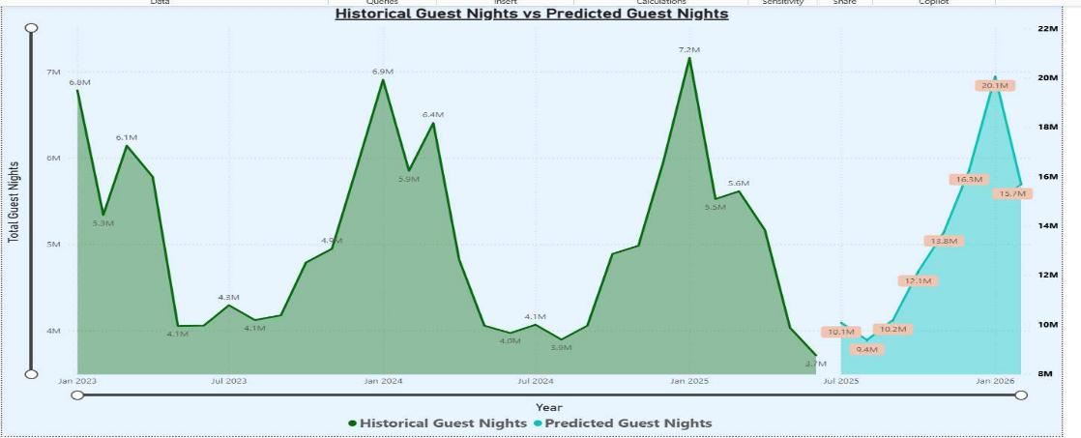
32. Guest Nights Page
• Focuses on accommodation data.
• Line chart compares historical and predicted guest nights.
• Highlights seasonal patterns and recovery after 2023.

Slide 33
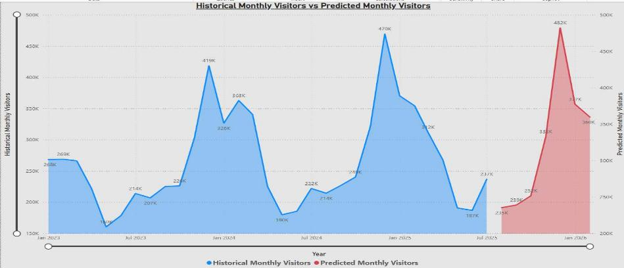
33. Visitor Arrivals Page
• Compares domestic and international visitor forecasts.
• Domestic arrivals show steady trends.
• International arrivals display post-pandemic recovery.

Slide 34
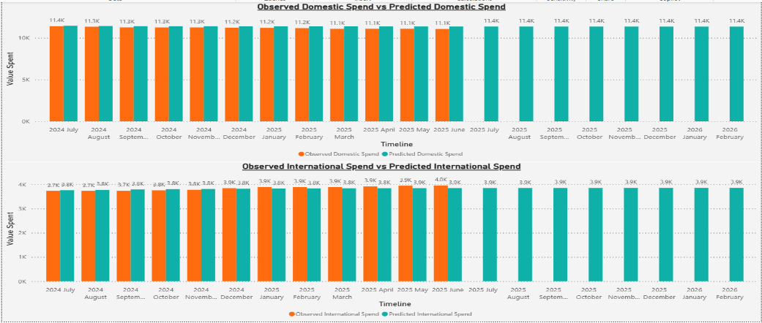
34. Spending Page
• Focuses on predicted domestic and international expenditure.
• Domestic spending shows consistent growth.
• International spending recovering gradually.
• Useful for forecasting revenue and planning budgets.

Slide 35
35. Live demonstration

Slide 36
36. Testing and Validation
The Power BI dashboard was thoroughly tested to ensure accuracy, functionality, and reliability prior to delivery, confirming that all visuals, calculations, and interactions performed correctly across all datasets
Testing Highlights:
Validated data accuracy, KPI cards, model results, and user interactions.
Checked dashboard performance, export functions, and responsiveness.
Executed 8 test cases – all passed successfully.
Ensured final dashboard reliability and readiness for client use.
Testing Environment:
Platform: Power BI Desktop
Datasets: Forecast outputs (Predicted Visitors, Guest Nights, Domestic & International Spend) and corresponding actuals for comparison
Visuals Tested:
Model Performance Chart
KPI Cards (Average Predicted Visitors)
Donut Chart (Domestic vs International Spend)
Clustered Column and Bar Charts
Line Graphs (Historical vs Predicted Data)

Slide 37
37. Test Cases
TC01 – Model Accuracy Performance: Match between dashboard and data source (Pass)
TC02 – KPI Card Calculation: Predicted visitors averaged correctly (Pass)
TC03 – Donut Chart: Domestic vs. International Spend consistency (Pass)
TC04 – Average Guest Night Graph: Average matches calculated value (Pass)
TC05 – Overlap/Gaps in Visitor Data: No overlap (Pass)
TC06 – Future Predictions: Only future months displayed (Pass)
TC07 – Unit Consistency: K for visitors, M for guest nights (Pass)
TC08 – Month Sequence: Correct chronological order (Pass)
TC09 – Cross Highlight Behaviour: Interactive dimming works (Pass)

Slide 38
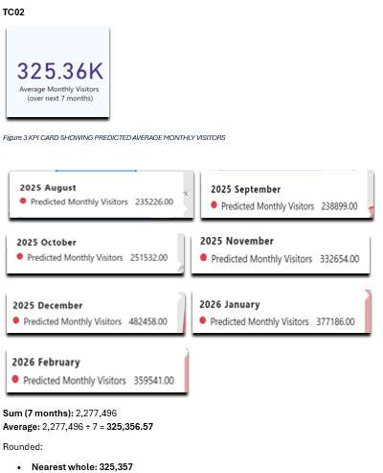
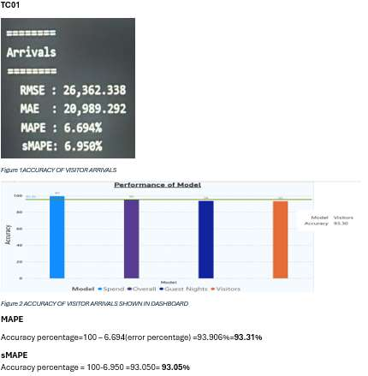
38. Testing Evidence

Slide 39
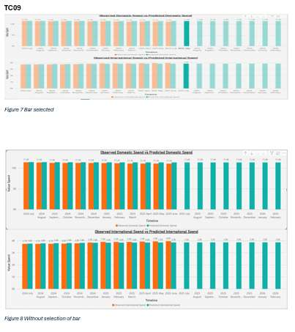
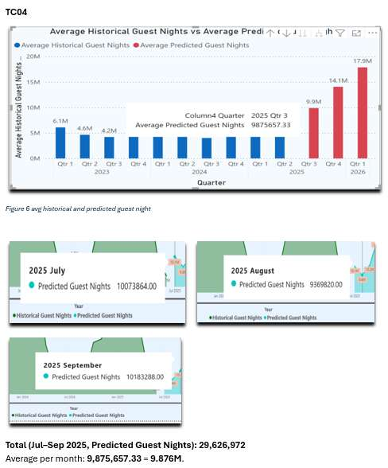
39. Testing Evidence (Cont’d)

Slide 40
40. Testing Conclusion
All test cases passed successfully.
The dashboard is accurate, reliable, and user-friendly.
Results confirm correctness of data, visuals, KPI logic, and interactivity.

Slide 41
41. Key Milestones
Week 2: Project Bid submitted and Client Assigned
Weeks 3 : Client (Dr Trang Do) outlined deliverables and the project objective.
Weeks 5 – 6: Initial forecasting models (ARIMA, SARIMAX, VAR, Random Forest) research. Project Proposal submitted. Data collection, cleaning and data validation for MBIE datasets started.
Weeks 7 – 10: Model refinement and dashboard design. Initial forecasting models (ARIMA, SARIMAX, VAR, Random Forest) development started.
Weeks 11 – 13: Final model tuning and testing. Forecast accuracy validated using RMSE, MAE, and MAPE. Power BI dashboards refined with additional insights and improved user interface. Week 12 – Mid-Client Review: Progress presented to our advisor, received feedback on model performance and visual presentation. Week 13 – Self-Management Review: Reflection on teamwork, communication, and sprint efficiency submitted.
Week 15 – Academic and Client Handover and Conducted final review with Dr Trang Do.
Week 16 –Panel Presentation

Slide 42
42. Changes in Methodology, Deliverables, or Dates
There were no major changes in the project methodology, the team continued following the Agile approach throughout the development process.
The only notable change was related to an academic deliverable, the Mid-Client Presentation.
Originally scheduled for Week 10, it was delayed to Week 12 because we did not receive a client response to confirm the meeting time. Instead, the presentation was delivered to our advisor, who provided detailed feedback on the project’s progress and documentation.
All updates and changes were recorded in our weekly reports and discussed during advisor meetings to maintain transparency and alignment with project expectations.

Slide 43
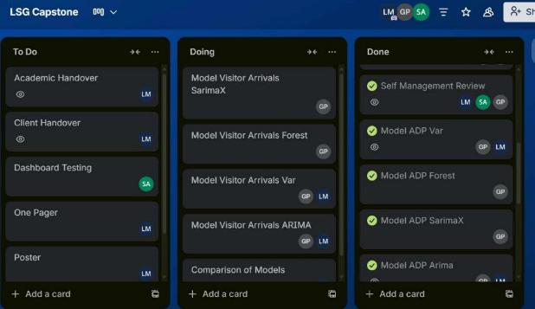
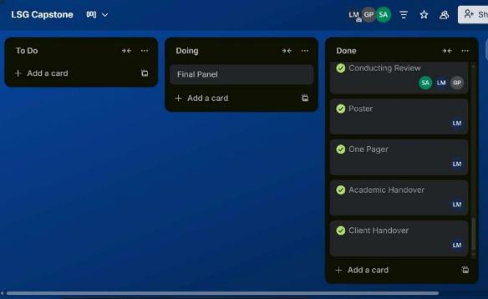
43. Trello

Slide 44
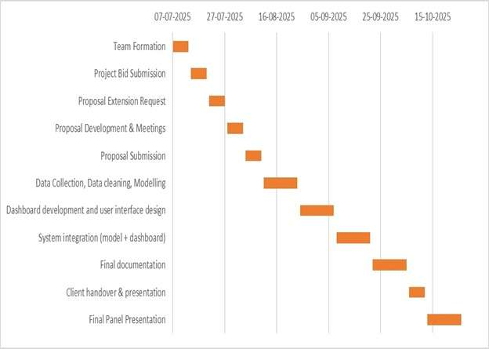
44.Gantt Chart (Period One)

Slide 45
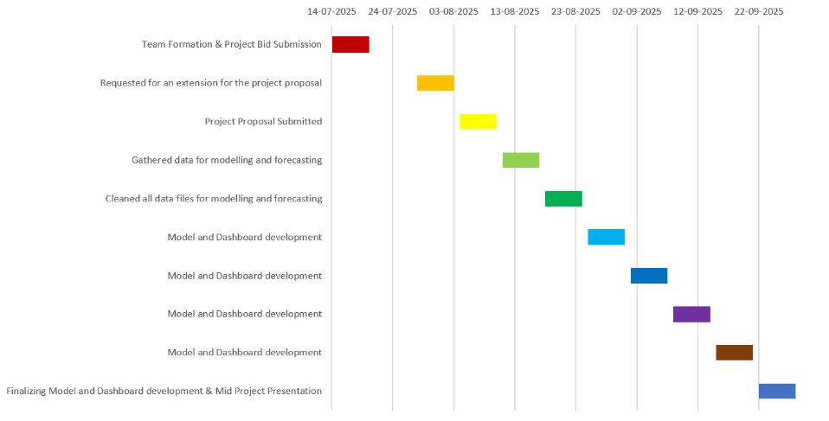
45. Gantt Chart (Period Two)

Slide 46
46. Client Feedback
The client provided overall positive feedback on our project, mentioning that it looked well-developed and visually appealing. However, there was a slight misunderstanding regarding the testing process of the data, specifically about the testing of data accuracy over a 12-month period.
We had conducted accuracy testing for the 12-month dataset, but we were unable to fully understand the client’s specific question during the discussion, which caused some minor confusion at that point.
From the client’s perspective, the dashboard design was impressive and effectively presented the information. She suggested modifying the layout and patterns of the visualization pages on the summary page to enhance clarity and visual flow.

Slide 47
Thank You
Team LSG - FutureTourism.LSG

